Slide 1

INTERMITTENT DEMAND FORCASTING FOR MEDICAL SUPPLY CHAIN DURING COVID -19 EPIDEMIC: REVIEW Intermittent demand forecasting for medical supply chains during the COVID-19 epidemic
Submitted to Prof. Chun Wang
Yu Jin
23753034
Concordia University

Slide 2
Abstract
Accurate demand forecasting is always critical to supply chain management. However, many uncertain factors
in the market make this issue a huge challenge. Especially during the current COVID-19 outbreak, the
shortage of certain types of medical consumables has become a global problem. The intermittent demand
forecast of medical consumables with a short life cycle brings some new challenges, such as the demand
occurring randomly in many time periods with zero demand. After review, a dynamic neural network model is found as the main forecasting model. Experimental results [1]show that the proposed forecasting framework is superior to other intermittent demand models.
Keywords: intermittent demand forecasting, medical supply chain, dynamic neural network, optimized model selection

Slide 3
Definition of Intermittent Demand Forecasting
Intermittent demand or ID (also known as sporadic demand) comes about when a product experiences several periods of zero demand. Often in these situations, when demand occurs it is small, and sometimes highly variable in size. [4]
The main characteristics of the intermittent demand forecast of medical consumables:
Large proportion of zero daily demands,
A large number of different products
Short life cycle
Short sell seasons
Long replenishment lead time,
Therefore, the intermittent and slow-moving nature of demand makes forecasting particularly difficult.
[4] Waller, D.. “Methods for Intermittent Demand Forecasting.” (2015).

Slide 4
Classification methodology
Papers are obtained through www.sciencedirect.com with the keyword "Demand forecasting " and "Intermittent demand forecasting", “Supply Chain management” and “medical supply chain management”. Paper in demand forecasting is classified into two types: Demand forecasting (DF) and Intermittent Demand forecasting (IDF) .
DF: Classification papers in “Demand forecasting “&& “Medical supply chain management”: 11 papers
IDF: Classification papers in “Intermittent Demand forecasting “&& “Medical supply chain management”: 17 papers
Date range: 2017-2020
With/Without PDF file: With PDF

Slide 5
Literature review: Our findings
Demand forecasting - minimum description length neural network (MDL-NN), is selected for Intermittent Demand Forecasting.
Performance assessment - Smoothed mean square error (MSE) has been selected to estimate the variance of demand forecast.
Model election is very important to forecast the demand for such short life cycle products because of the considerable irregularity data. In our research, a new forecasting accuracy measure for the model to deal with zero demand, and introduce a dynamic neural network, minimum description length neural network (MDL-NN), as the core part of the forecasting model. MDL was originally used to minimize the sum of length, which includes an effective description of the model and length, and an effective description of the data when coding with the model In time series forecasting, the description length of a model is the sum of the model description length and the model prediction error. MDL-NN searches for the optimal model size (i.e. the number of neurons in neural network),and avoids overfitting or underfitting by minimizing the model’s description length and its performance. [1]

Slide 6
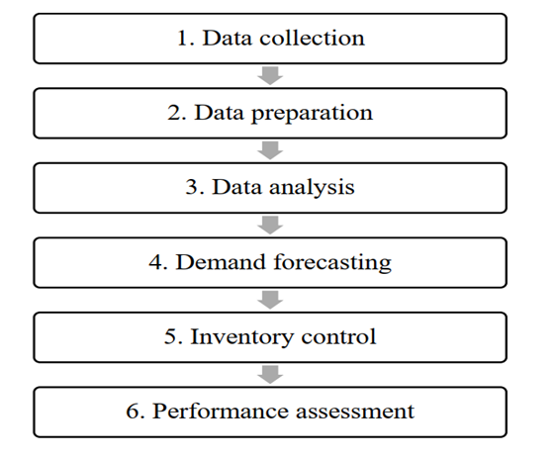
1 Literature review: Optimized model selection procedure
Literature review on model optimization: [1][3][4][6][7][9], we find optimized model selection procedure. Therefore, the remainder of this study is structured as follows:
Section 2: Literature review in data aggregation
Section 3: Literature review in demand forecasting and selection
Section 4. Literature review in performance assessment
Section 5: Literature review in experiment result
Section 6: Conclusion and future research directions.

Slide 7
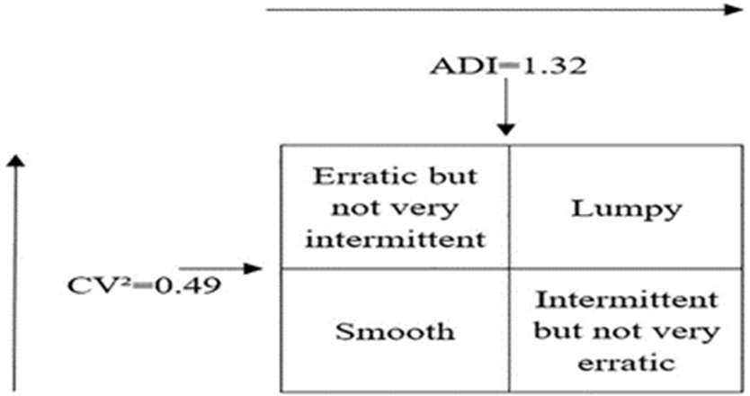
Demand classification
Demand could be smooth, intermittent, lumpy, erratic and slow-moving. The two most popular indicators are Average inter-Demand Interval (ADI) and Coefficient of Variation (CV).Traditional method SES and MA are not good for intermittent demand. We look for new methods that can supply chain decisions during the COVID-19 epidemic
[The purpose of model specification and selection is to find the most suitable model for a given data set.

Slide 8
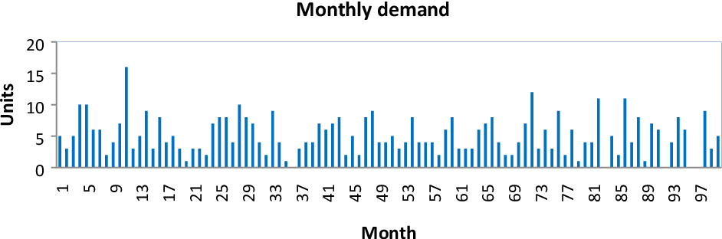
An example of erratic data ---medical epidemic [9]

Slide 9
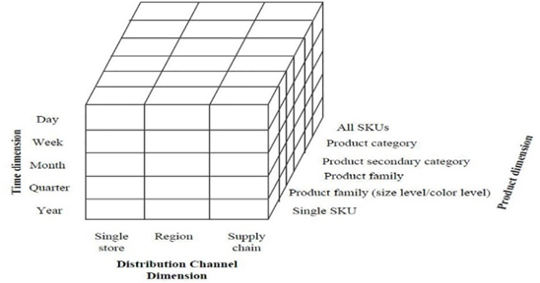
Literature review: Data Aggregation
Intermittent demand forecasting-large proportion of zero demands => Solution: Aggregate demands.
Data aggregation is a systematic work, and various aspects should be considered. Syntetos et al.[22] established a supply chain structure, which includes four dimensions for supply chain forecasting, namely product dimension, location dimension, time dimension and echelon dimension. Figure 1 depicts the three dimensions of data aggregation, where each small block represents one choice of data aggregation. In this study, we select SKU-Day-Chain level to aggregate the demand

Slide 10
Literature review: Previous Intermittent Demand Forecasting Methods
Numerous forecasting methods have been proposed, such as moving averages ( MA) and exponential smoothing ( SES) [26] Holt-Winters exponential smoothing[14 ]autoregression, artificial neural networks, extreme learning machines,[15],[16] evolutionary neural networks,[11]the hierarchical Bayesian approach[27] and hybrid model[12] More detailed and extensive reviews on these forecasting methods can be found in Nenni et al.,1 Thomassey,[9] and Liu et al.[25] Liu et al. divided sales forecasting methods into three groups, namely statistical forecasting methods, advanced statistical learning forecasting methods and hybrid forecasting methods. [1]
Method | Advantage | Disadvantage
Statistical forecasting methods | Simple and fast | - Not for irregular patterns
advanced statistical learning forecasting method | Stronger ability to identify irregular patterns | - Time-consuming - Sufficient data needed - Can not predict promptly
Hybrid forecasting methods |  | - Advanced statistical learning procedure + other processes. - Time consuming

Slide 11
Literature review: Demand Forecasting Model Selection [[1][4][6][7][8][9][12][13][14][16]]
Reference | Abstract / Conclusion
[1]- sMDL-NN | An appropriate model selection criterion is introduced to determine the optimal model. In order to tackle the problem of erratic demand, dropping outliers, seasonal adjustment techniques and aggregation technique are introduced. In addition, a new forecasting accuracy estimator is proposed to improve the generalization capability of zero-demand data. Six other benchmark methods are also applied, namely Syntetos and Boylan’s method, GM, SVM, MS, ELM and NN. Our experimental results show that the performance of our proposed method outperforms others. Our findings suggest that due to the complexity of sales data, managers should consider model selection, and sMDL-NN is an ideal candidate model to achieve this goal. The numerical investigation is conducted at the supply chain level. Experimental results and encompassing tests indicate that our proposed sMDL-NN model is superior. The forecasting results of the proposed RMAPE are consistent with MAE
[9] | Performance results are evaluated for all methods and for all demand types. Based on the performance results, order of methods according to their success results is obtained
[12] | The result of the analysis shows that traditional forecast accuracy measure is inadequate for selecting best forecast model. Nevertheless, our result shows that no forecast method (Simple Exponential Smoothening (SES), Croston and Modified Croston (SBA) explicitly showed superior performance in all the traditional measures utilized.[12]
[13] | The intermittent demand patterns for medical supplies are generally classified as lumpy, erratic, smooth, and slow-moving demand. This study was conducted with the purpose of advancing a tertiary pediatric intensive care unit’s efforts to achieve a high level of accuracy in its forecasting of the demand for medical supplies. On this point, several demand forecasting methods were compared in terms of the forecast accuracy of each. The results confirm that applying Croston’s method combined with a single exponential smoothing method yields the most accurate results for forecasting lumpy, erratic, and slow-moving demand, whereas the Simple Moving Average (SMA) method is the most suitable for forecasting smooth demand. In addition, when the classification of demand consumption patterns were combined with the demand forecasting models, the forecasting errors were minimized, indicating that this classification framework can play a role in improving patient safety and reducing inventory management costs in health care institution
[14] | Demand forecast accuracy in the service supply chains e.g. spare parts is critical for customer satisfaction and its financial performance. This is a typical logistic network which is affected by irregular demand resulting from contract and non-contract business strategies. Hence, existing forecasting methods that work excellent with smooth and linear demand patterns become less accurate with increasing erratic, lumpy and intermittent demands. Moreover, increasing number of stock keeping units (SKUs) in service supply chains have computational limitations. This is because of the fact that demand keep on fluctuating their demand classes that result in uncertainty and consequently, leads to higher target stock levels (TSL) and lower reorder point (ROP) to ensure higher customer satisfaction. This raises interest in using AI for service supply chains to improve demand forecast accuracy. In this paper, we present a survey of existing forecasting methods used in service and non-service supply chains to select best performing AI methods and performance measures, using ABC classification. Neural network (NN) and Mean Square Error (MSE), are subsequently modelled and used in aircraft spare parts supply chain using data collected from Dassault Aviation, as a function of most commonly used aggregated demand features. The results are compared with frequently and best performing forecast methods for intermittent demand as Croston, Croston SBJ and Croston TSB; and classical methods as moving average (MA) and single exponential smoothening (SES). The analysis and results suggest that NN with higher number of features improve demand forecast accuracy significantly for intermittent demands along with reduction in associated financial implications
[16] | In empirically investigating the forecasting methods on the performance block (the final 22 months of the 66-month actual distribution) using three traditional statistical measures of forecast accuracy, we found none of the methods under consideration to be consistently superior to the others. However, when the methods are tested over considerably more time periods (100 replications of 100 months using our two-stage approach), SBA is found to be the best performing method overall in terms of statistical accuracy.

Slide 12
Literature review: Demand Forecasting Model Selection –Summary
The results are compared with frequently and best performing forecast methods for intermittent demand as Croston, Croston SBJ and Croston TSB; and classical methods as moving average (MA) and single exponential smoothening (SES). The analysis and results suggest that NN with higher number of features improve demand forecast accuracy significantly for intermittent demands along with reduction in associated financial implications [14]
For the intermittent demand forecasting problem of medical consumables with a short life cycle, this study provides a dynamic neural network model based on optimized model selection procedure to select optimal structure of neural network. One critical issue we have to address is to avoid underfitting and overfitting, especially in our limited historical data, which is essentially the problem of model selection. We take an appropriate model selection to determine the optimal model. In order to tackle the problem of erratic demand, dropping outliers, seasonal adjustment techniques and aggregation technique are introduced. [1]

Slide 13
4. Literature review: Demand Forecasting Performance Assessment
Reference | Abstract | Accuracy Metrics
[14] | In this paper, we present a survey of existing forecasting methods used in service and non-service supply chains to select best performing AI methods and performance measures, using ABC classification. Neural network (NN) and Mean Square Error (MSE), are subsequently modelled and used in supply chain using data collected from Dassault Aviation, | MSE
[1] | The RSMAPE method imposes a larger penalty on the underestimated values on the overestimated values. This property is extremely appropriate for the sales forecasting. Although underestimation does not increase inventory cost, it results in not only losing current sales and revenue reduction, but also decreasing the level of customer satisfaction. Demand overestimation only increases the inventory cost. The MAE does not have this property. However, in our background, the value of samples is small, thus, big MAPE value doesn’t always indicate that the model is ineffective, MAE is more appropriate than other two measurements to judge the effectiveness of model. | MAE
[6] | Among various measures, MASE has been highly recommended for intermittent demand because it is scale-free and less sensitive to the existence of trend and/or seasonality (Hyndman, 2006); RGRMSE has also been shown to be a robust measure in the presence of outliers (Syntetos & Boylan, 2005). Another important measure for our study is the RMSE. Despite its scale-dependency it is a useful measure to estimate demand variation (or standard deviation) for inventory control purposes. In this study, smoothed mean square error (MSE) has been used to estimate the variance of our forecast. | MSE
[4] | Example scale-dependent metrics include the Mean Squared Error (MSE), the Mean Absolute Error (MAE), the Mean Absolute Percentage Error (MAPE) which is simply defined as the mean The key metric in this category is Mean Absolute Scaled Error (MASE) | MAE MAPE GMRAE MASE
[8] | That is, the first observations are used as an optimization sample to select the smoothing parameter over the range 0.05 to 0.30 (in steps of 0.01) that minimizes the mean squared error (MSE) per series. | MSE

Slide 14
4. Literature review: Demand Forecasting Performance Assessment - Continue
In summary: After review, we present a survey of existing forecasting methods used in service and non-service supply chains to select best performing AI methods and performance measures, using ABC classification. Neural network (NN) and Mean Square Error (MSE), are subsequently modelled and used in supply chain using.[14] Smoothed mean square error (MSE) has been selected to estimate the variance of demand forecast.

Slide 15
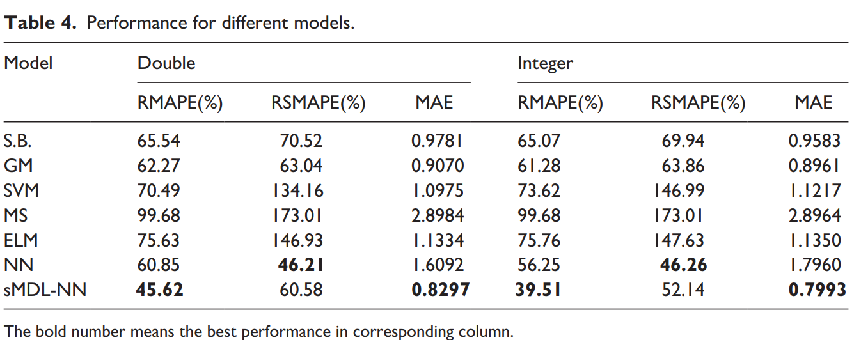
5. Literature review -Experiment result [1]&[14]
Result: Six other benchmark methods are evaluated: Syntetos and Boylan’s method, GM, SVM, MS, ELM and NN. Our experimental results show that the performance of MDL-NN method outperforms others [1]

Slide 16
6. Conclusion & Further research
Conclusion:. For the intermittent demand forecasting problem of medical consumables with a short life cycle, the finding of my literature review is a dynamic neural network model based on optimized model selection procedure to select optimal structure of neural network. One critical have to address is to avoid underfitting and overfitting, especially in our limited historical data, which is essentially the problem of model selection.
In order to tackle the problem of erratic demand, dropping outliers, seasonal adjustment techniques and aggregation technique are introduced. In addition, a new forecasting accuracy estimator is proposed to improve the generalization capability of zero-demand data. Experimental results show that the performance of MDL-NN outperforms others.
Further research: Intermittent demand management is a very complicated issue. Further research can be to integrate the forecasted results into inventory, logistics distribution, and pricing operations, such as markdown decisions, to develop models and algorithms to solve practical problems.

Slide 17
Reference
[1] Liu, Peipei. "Intermittent demand forecasting for medical consumables with short life cycle using a dynamic neural network during the COVID-19 epidemic." Health informatics journal (2020): 1460458220954730 [2] Burgess, K. et al. “Supply chain management: a structured literature review and implications for future research.” International Journal of Operations & Production Management 26 (2006): 703-729. [3] Takeyasu, Daisuke et al. “Improving Forecasting Accuracy in the Case of Intermittent Demand Forecasting.” International Journal of Advanced Computer Science and Applications 5 (2014): n. pag. [4] Waller, D.. “Methods for Intermittent Demand Forecasting.” (2015). [5] Argyrios Syntetos “Forcasting of intermittent demand” ( 2001) [6] Ngan Ngoc Chau “Intermittent Demand Forecasting for Inventory Control: The Impact of Temporal and Cross-sectional Aggregation” (2020) [7]Kourentzes, N.. “On intermittent demand model optimisation and selection.” International Journal of Production Economics 156 (2014): 180-190. [8] Syntetos, A. et al. “Forecasting intermittent inventory demands simple parametric methods vs. bootstrapping ☆.” Journal of Business Research 68 (2015): 1746-1752.

Slide 18
Reference
[9] Kaya, Gamze Ogcu et al. “Intermittent demand forecasting: a guideline for method selection.” Sādhanā 45 (2020): 1-7. [10] Lolli, F. et al. “Machine learning for multi-criteria inventory classification applied to intermittent demand.” Production Planning & Control 30 (2019): 76 - 89. [11] Syntetos A A and Boylan J E 2005 The accuracy of intermittent demand estimates. International Journal of Forecasting 21: 303–314 [[12]Oguji, Nnamdi. “Forecasting for intermittent spare parts in single-echelon multi-location and multi-item logistics network: Case KONE Global Spares Supply.” (2013) [13] Cheng, Chen-Yang et al. “Intermittent Demand Forecasting in a Tertiary Pediatric Intensive Care Unit.” Journal of Medical Systems 40 (2016): 1-12. [14] Amirkolaii, K. N. et al. “Demand Forecasting for Irregular Demands in Business Aircraft Spare Parts Supply Chains by using Artificial Intelligence (AI).” IFAC-PapersOnLine 50 (2017): 15221-15226. [15]Martin, D. et al. “A New Metric for Lumpy and Intermittent Demand Forecasts: Stock-keeping-oriented Prediction Error Costs.” ArXiv abs/2004.10537 (2020): n. pag. [16] Nicoletti, L. et al. “Intermittent demand forecasting and stock control: An empirical study.” (2013). [17] Molina, A. and J. Parreño. “Forecasting erratic demand of medicines in a public hospital : A comparison of artificial neural networks and ARIMA models.” (2016).

Slide 19
Reference
[18] Zeynep Hilal Kilimci, A. Okay Akyuz, Mitat Uysal, Selim Akyokus, M. Ozan Uysal, Berna Atak Bulbul, Mehmet Ali Ekmis, "An Improved Demand Forecasting Model Using Deep Learning Approach and Proposed Decision Integration Strategy for Supply Chain", Complexity, vol. 2019, Article
[19] “A Machine-learning-based System for prediction service level Failures in Supply Chains”
[20] Luis Aburto, Richard Weber,”Improved supply chain management based on hybrid demand forecasts”, Applied Soft Computing, Volume 7, Issue 1, 2007, Pages 136-144, ISSN 1568-4946,
[21] He Y, Liu N. Methodology of emergency medical logistics for public health emergencies. Transp Res E Logist Transp Rev. 2015 Jul;79:178-200. doi: 10.1016/j.tre.2015.04.007. Epub 2015 May 17. PMID: 32288598; PMCID: PMC7147567.[
[22] GabRIELLE Gauthier Melancon , A Machine Learning Based System for Predicting Service Level Failures in Supply Chains
[23] Tugay, R. and S. Ögüdücü. “Demand Prediction using Machine Learning Methods d Stacked Generalization.” DATA (2017).
[24]Aburto L., Weber R. (2007) A Sequential Hybrid Forecasting System for Demand Prediction. In: Perner P. (eds) Machine Learning and Data Mining in Pattern Recognition. MLDM 2007. Lecture Notes in Computer Science, vol 4571. Springer, Berlin, Heidelberg. https://doi.org/10.1007/978-3-540-73499-4_39
[25] Abolghasemi, M. et al. “Demand forecasting in supply chain: The impact of demand volatility in the presence of promotion.” Comput. Ind. Eng. 142 (2020): 106380.
[26] López, C. and A. Ishizaka. “A hybrid FCM-AHP approach to predict impacts of offshore outsourcing location decisions on supply chain resilience.” Journal of Business Research 103 (2017): 495-507.
[27] Islam, Samiul and S. Amin. “Prediction of probable backorder scenarios in the supply chain using Distributed Random Forest and Gradient Boosting Machine learning techniques.” Journal of Big Data 7 (2020): 1-22.
[27] Syahrir, I. et al. “Healthcare and Disaster Supply Chain: Literature Review and Future Research.” Procedia Manufacturing 4 (2015): 2-9.
[28] Brintrup, A. et al. “Supply chain data analytics for predicting supplier disruptions: a case study in complex asset manufacturing.” International Journal of Production Research 58 (2020): 3330 - 3341.
[29] Baryannis, George et al. “Supply chain risk management and artificial intelligence: state of the art and future research directions.” International Journal of Production Research 57 (2019): 2179 - 2202.

Slide 20

Thank you !
Q & A

